Slide 1






PowerShell Conference Asia
How to deploy, use and administrate a Kubernetes cluster on Azure

Slide 2

Whoami
Azure Architect at Orange Business Services
Rennes City France
MVP Cloud and Datacenter Management
French PowerShell User Group
In love with Docker and Kubernetes
PowerShell Conference
Singapore 2017

Slide 3
Agenda
What is Kubernetes ?
How Kubernetes works with Azure ?
Deploy Kubernetes on Azure
Create an app on Kubernetes
Operate a Kubernetes cluster
PowerShell Conference
Singapore 2017

Slide 4

PowerShell Conference Asia
What is Kubernetes ?

Slide 5
A container’s orchestrator
Created at first by Google
Open source platform for containers to
Automate deployments
Automate scales
Operate application containers
Run everywhere
PowerShell Conference
Singapore 2017
Notes:
With Kubernetes, you are able to quickly and efficiently respond to customer demand:
Deploy your applications quickly and predictably.
Scale your applications on the fly.
Roll out new features seamlessly.
Limit hardware usage to required resources only.
Run everywhere: public cloud, private cloud, hybrid or multi-cloud

Slide 6
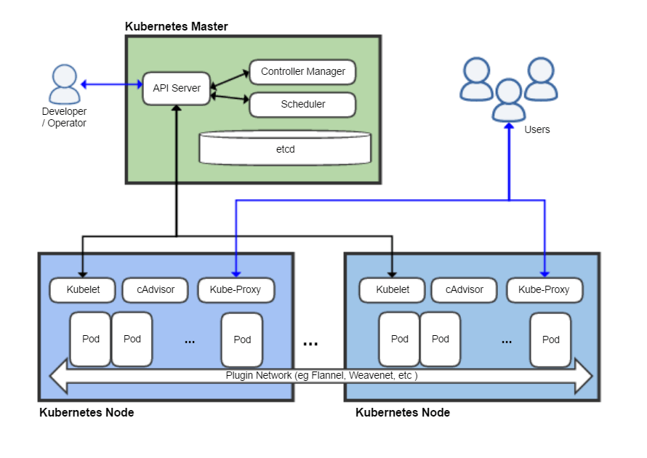
How Kubernetes works ?
Source wikipedia
PowerShell Conference
Singapore 2017

Slide 7

PowerShell Conference Asia
How Kubernetes works with Azure ?

Slide 8
Running Kubernetes on Azure
Kubernetes Azure cloud provider
https://github.com/kubernetes/kubernetes/tree/master/pkg/cloudprovider/providers/azure
Totally integrated in core Kubernetes
Kubernetes interacts with Azure thanks to a principal service account.
PowerShell Conference
Singapore 2017

Slide 9
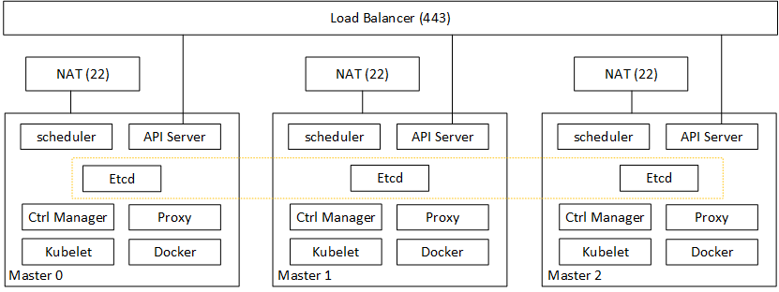
Kubernetes masters on Azure
PowerShell Conference
Singapore 2017

Slide 10
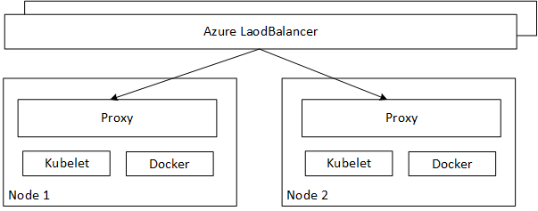
Kubernetes nodes on Azure
PowerShell Conference
Singapore 2017

Slide 11

PowerShell Conference Asia
How to deploy a Kubernetes cluster Azure ?

Slide 12
Tools you might need
Azure Container Services ☹
https://portal.azure.com
ACS Engine ☺
https://github.com/Azure/acs-engine
Tectonic ☺
https://coreos.com/tectonic/docs/latest/install/azure/azure-terraform.html
PowerShell Conference
Singapore 2017

Slide 13
Our tiny k8s cluster
PowerShell Conference
Singapore 2017

Slide 14
ACS Engine
DEMO
PowerShell Conference
Singapore 2017

Slide 15
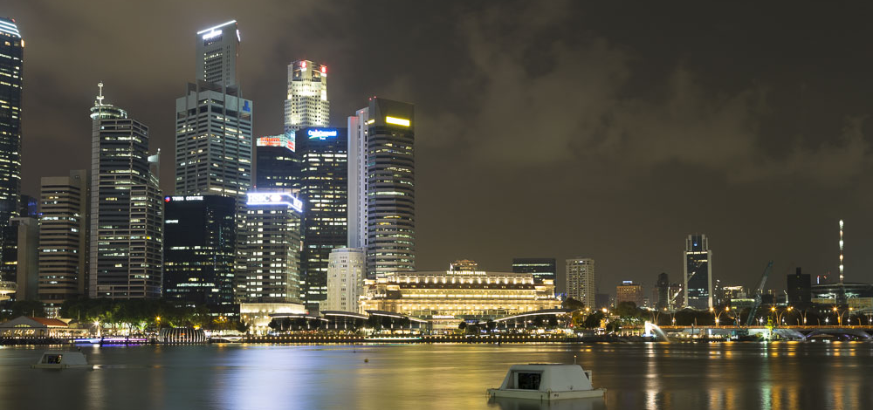
PowerShell Conference Asia
Deploy your app on your Kubernetes cluster

Slide 16
Deploy your application in Kubernetes
No click-to-deploy marketplace
You choose your logging, monitoring and alerting solution
No limit of applications types that are supported
YAML or JSON declarative files
Private or public Docker repositories
Kubectl is your (new) best friend
PowerShell Conference
Singapore 2017

Slide 17
Azure cloud provider
You can
Use managed disks for persistant datas
Take advantage of Azure load balancers
Public or private
Use Azure Container Registry
Interact with every single PaaS services
Use service across your Express Route/VPN
You can’t have (for now) use cross resource group services
PowerShell Conference
Singapore 2017

Slide 18
Kubectl create
DEMO
PowerShell Conference
Singapore 2017

Slide 19

PowerShell Conference Asia
Operate your app on Kubernetes

Slide 20
Kubectl is again your friend
Kubectl will help you on
Scaling your pods
Making changes on your pods/services/statefulsets
Starting a proxy to access admin dashboard
Access logs for troubleshooting
Making you coffee ☺
PowerShell Conference
Singapore 2017

Slide 21
Automatic scaling
Pods automatic scaling
Nodes automatic scaling
https://github.com/wbuchwalter/Kubernetes-acs-engine-autoscaler
No virtual Machines Scale Sets (yet)
PowerShell Conference
Singapore 2017

Slide 22
Scaling your application/Cluster
DEMO
PowerShell Conference
Singapore 2017

Slide 23
Operations process
Grant access with RBAC with certificates
On namespaces
On specific resources
Not related with Azure RABC or anything else
PowerShell Conference
Singapore 2017

Slide 24
Monitoring
Many solutions available
OMS
Prometheus/Grafana
Datadog
PowerShell Conference
Singapore 2017

Slide 25
Monitoring
DEMO
PowerShell Conference
Singapore 2017

Slide 26
Backup
Docker does not like backup
Persistent disks aren’t enough
Kubernetes Cronjob
Not supported in production
PowerShell Conference
Singapore 2017

Slide 27
MongoDB Backup
DEMO
PowerShell Conference
Singapore 2017

Slide 28
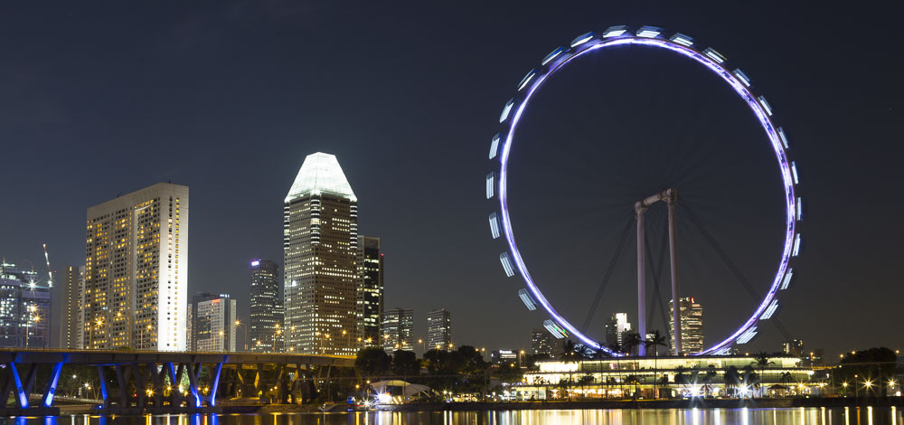
PowerShell Conference Asia
Azure Managed Kubernetes

Slide 29
Azure Kubernetes Service
Packaged & Managed Kubernetes cluster
Deployment using Azure Cli 2.1
Free: Pay only for VMs using behind the scene
Not fitted for specifics need
No autoscaling nodes (yet)
Not (yet) integrated with Azure RBAC
PowerShell Conference
Singapore 2017

Slide 30
PowerShell Conference Asia
Conclusion

Slide 31
Key points
DO NOT USE ACS !!
Do not hesitate to use separated pools
Use versioning for your yaml files
Monitor essential for a production
PowerShell Conference
Singapore 2017

Slide 32
Don’t Forget!
Fill in your survey in Mobile app – it’s how we do better!
Don’t lose you badge! You need it for the Social Events
Grab the Speakers for a chat – they all have time for you!
Let everyone know what they are missing on Social Media
#PowerShell
#PSConfAsia
Photos of Marina Bay Credit: Sebastian Szumigalski
PowerShell Conference
Singapore 2017

